Slide 1
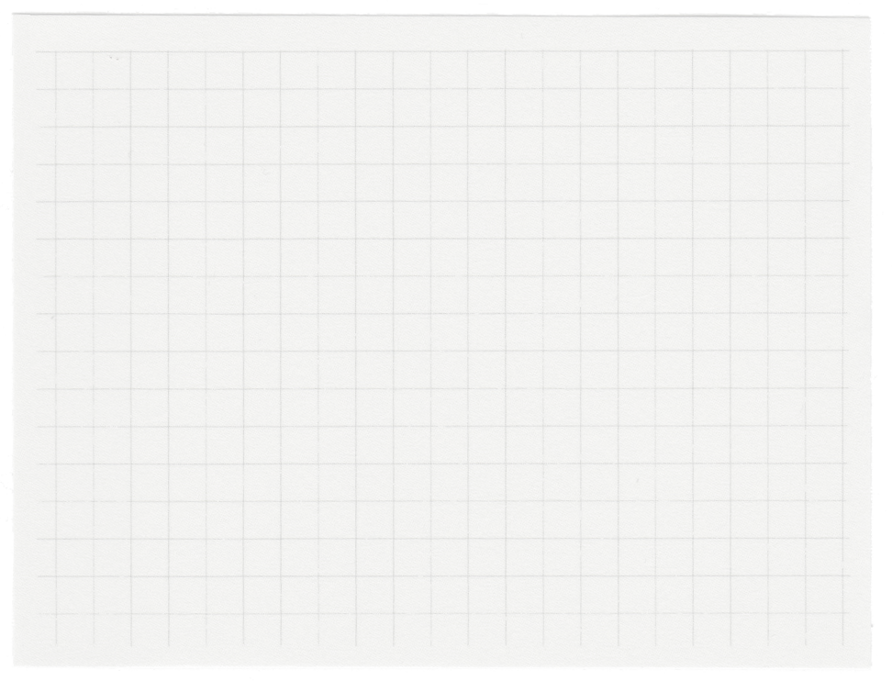




image segmentation!
used pre-trained models -
> started with mask r-cnn
>tried segment anything model (SAM)
>yolo v8 for instance segmentation

Slide 2
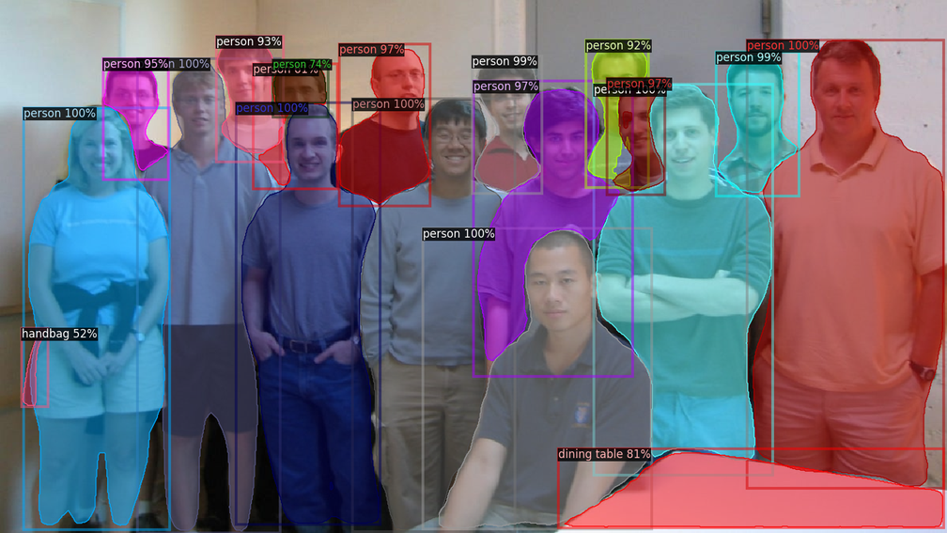
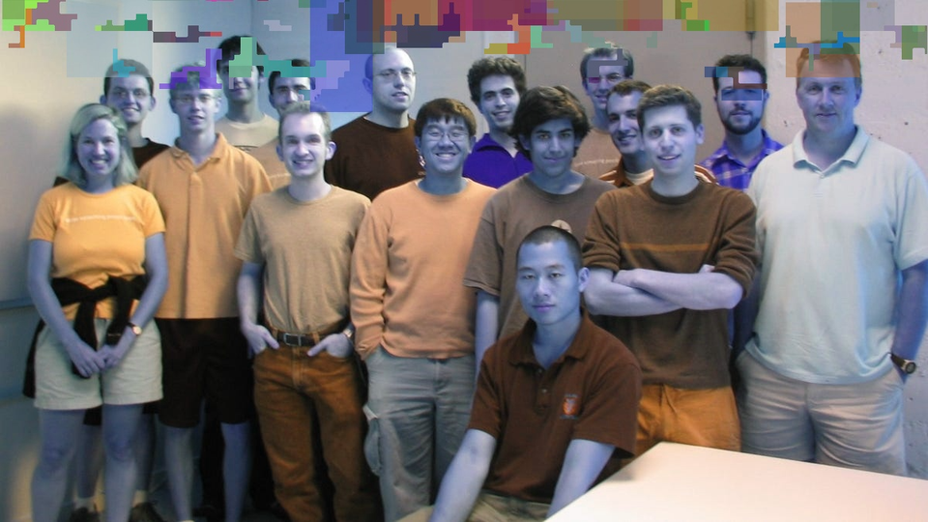
what i wanted!
what i got! not good enough at all!

Slide 3
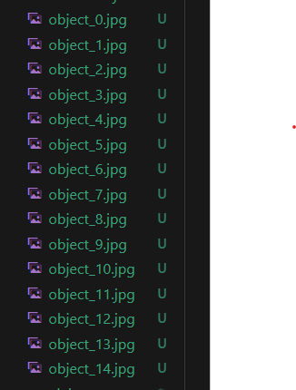
object extraction
used pillow (python imaging library) with open cv
extracted objects & saved in file system (in the segmented objects directory) with unique object id’s

Slide 4
identification
using open ai’s clip (good at zero shot object detection)
a small description of objects in the image! what this could be?

Slide 5
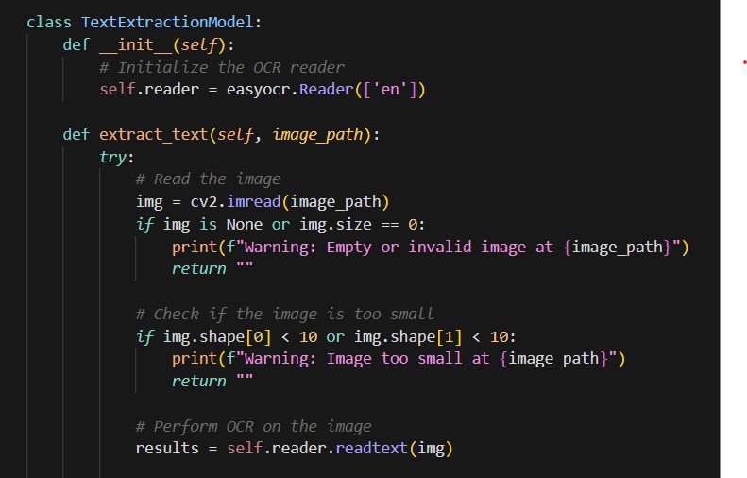
text extraction
used easy ocr
identifies any text on the image -> extracts it and return text to be used for summarization

Slide 6
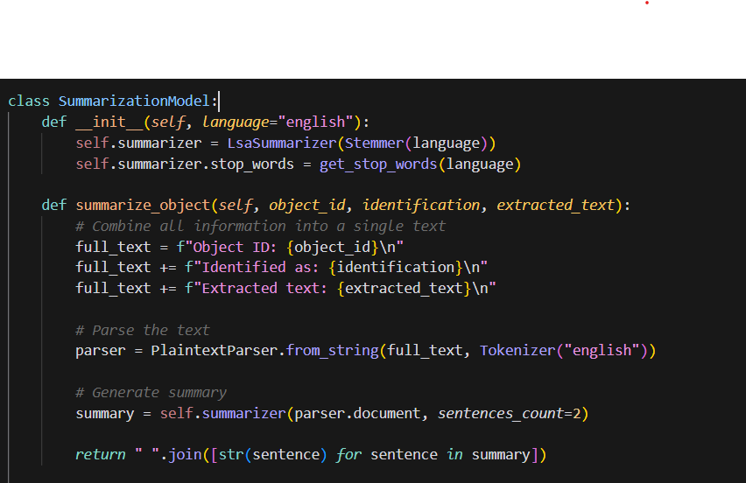
summarization
used sumy python library
lsa summarizer (latent semantic analysis) algo for generating summary
it returns summary for each object in the image

Slide 7
mapping + output
used JSON for generating mapped output
it maps all the objects with their : object id’s , segmentation, identification, extracted text & summary
takes mapped objects & generates output image with a csv file containing all object id’s, identification, extracted text & summary
and saves both outputs in the output directory

Slide 8
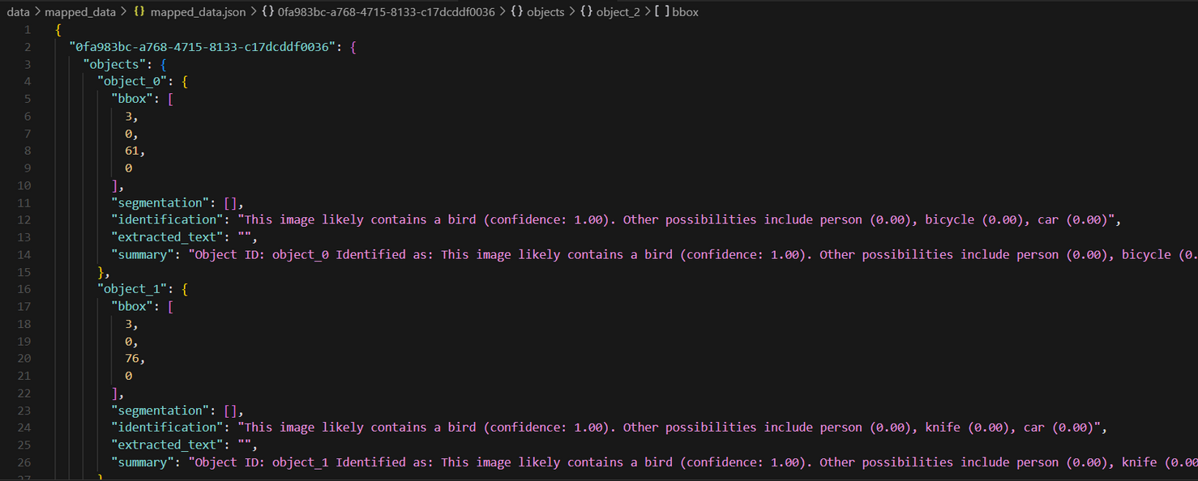
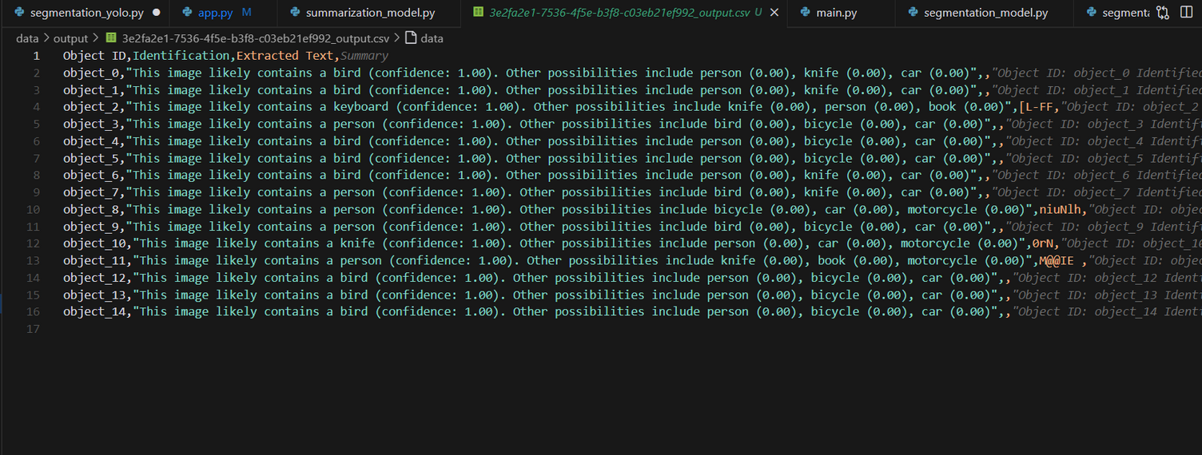

Slide 9
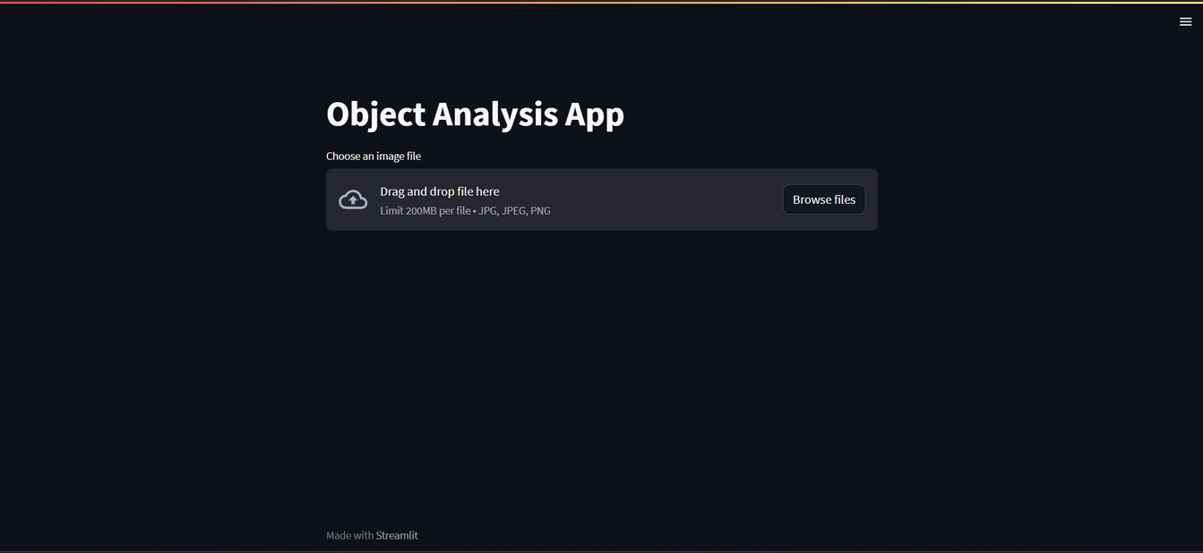
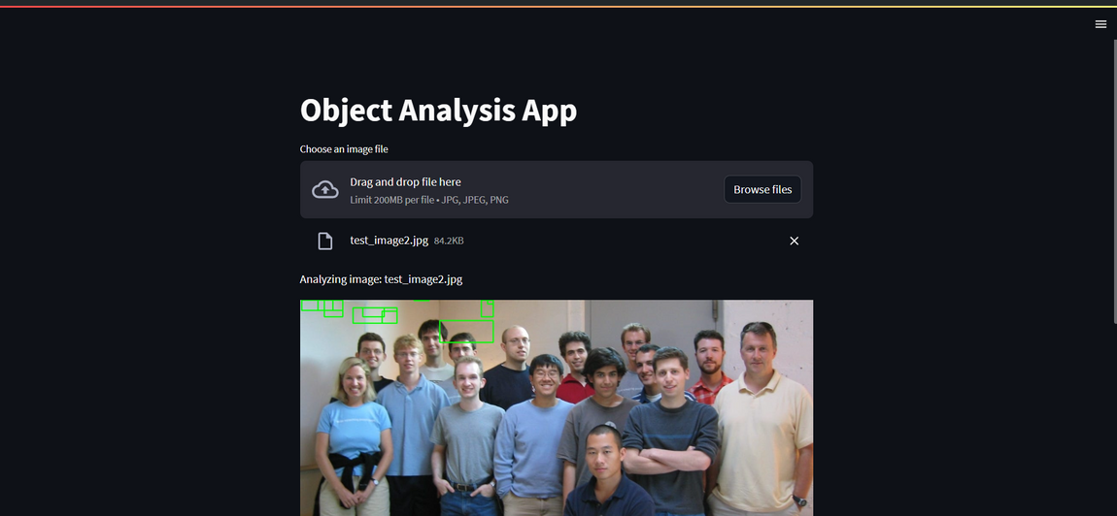
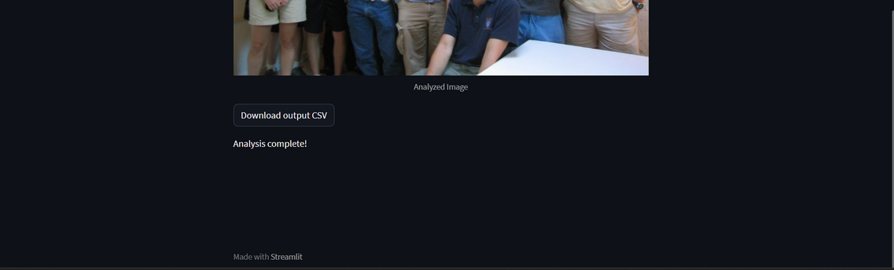
streamlit UI

